Slide 1



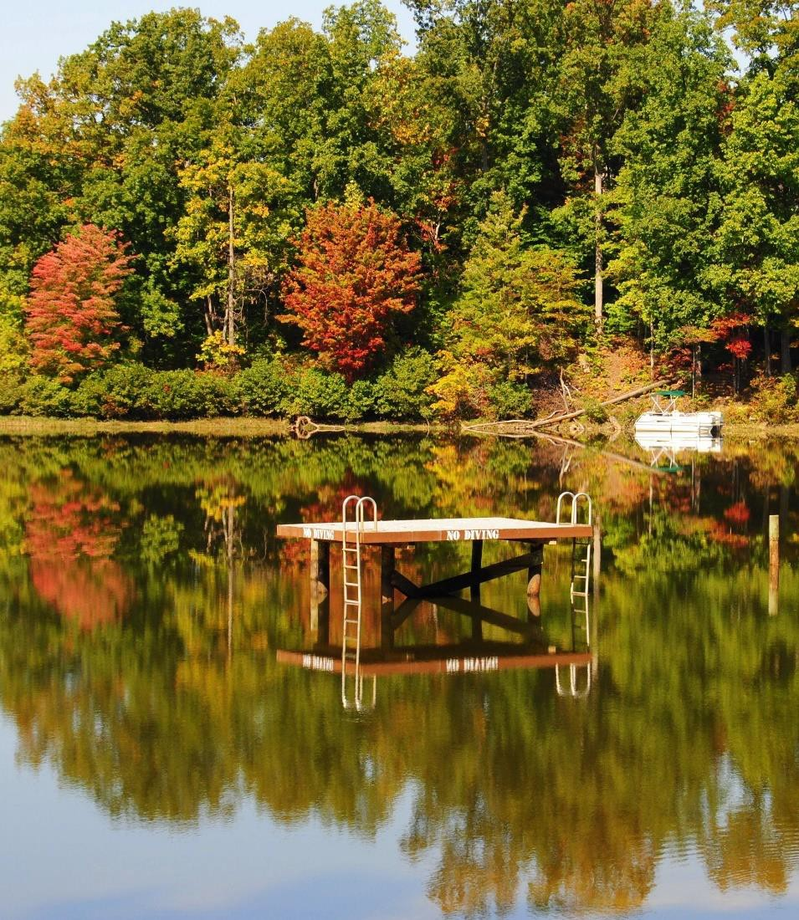




2025 Montclair Swim Festival

Slide 2

◻ Requirements
Monitoring Swimmers During Race
Safety Communication Plan
Feeding Station (more than 5K)
Course Evacuation Plan
Medical Services
Accounting For Swimmers
Technical Meeting/Briefing
Safety during warm-up and warm-down
Water and Air Temperature
Water Quality
2

Slide 3
1. Monitoring Swimmers During Race
2025 Plan:
ARC Certified Lifeguards (6-10), and volunteer Kayakers (10) will be used.
All athletes will be observed at all times in the race by a member of the safety team. Elimination of “blind spots” is the primary goal.
The course is a closed to the public lake. 2,500 meter out and back course, parallel to the beach, averaging 15- 20 meters from the shoreline. No motor boats are allowed in Lake Montclair.
The race course will be broken down into 12 zones of ~100 meters each, with the following “first responders” as safety personnel:
a. Shoreline side: One certified Lifeguard and 1 volunteer for each 200 meters. There will be a total of 6-8 Lifeguards for the shoreline side and 5 volunteers. Each lifeguard will carry a
Guard Rescue Tube (40 inch minimum).
3

Slide 4
1. Monitoring Swimmers During Race
2025 Plan:
(Continued)
Outside of Course: 1 volunteer kayaker and 1 certified Lifeguard on a paddle board for each 200 meters. There will be a total of 6-8 life guards and 5 Kayakers or Paddle-boarders on the outside of course. Additionally, there will be 6 PWC Fire & Rescue personnel in a powered skiff.
All “first responders” shall have the capacity to react to a need for assistance within 10 seconds, and are able to reach the swimmer within an additional 20 seconds.
With an anticipated 200 athletes on the course at the peak of competition, providing a gross ratio of one first responder per
8.3 athletes. A first responder ratio of one per 20 athletes is
recommended.
Additional: 3 pontoon boats for Officials/Safety Monitor (1 at each turn, 2 PWC Paramedics at start/finish.
4

Slide 5
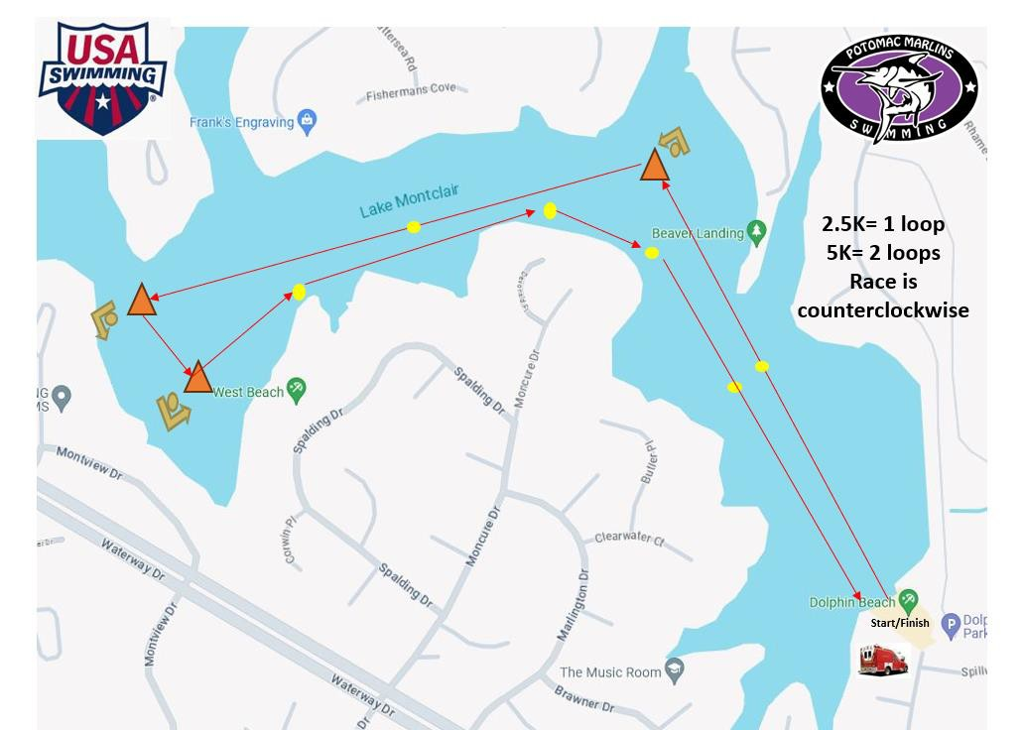
5K & 2.5K Courses
5

Slide 6

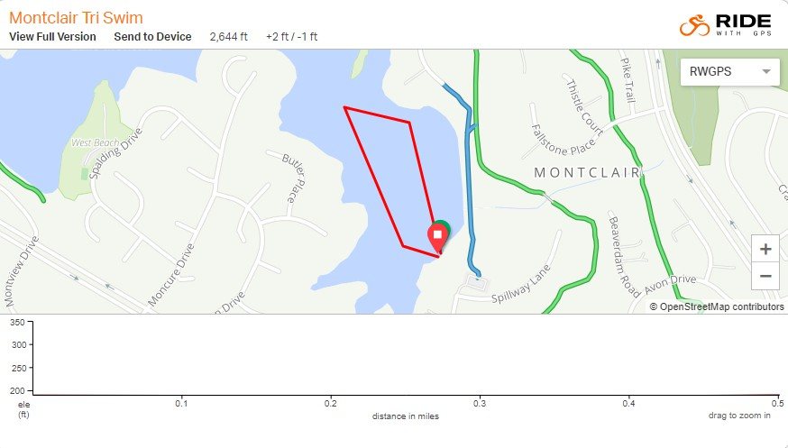





1.5K/ 750m Course
loop= 750m
loops = 1.5K
Start/finish

Slide 7

2024 Montclair Swim Festival
Actual Timeline & Number of Swimmers on course
Event
Gender
Age Distance Total Start Time
1st Finish
50% Finish
Last Finish
1
Boys
13+
5K
11
9:00 AM
9:57AM
10:15 AM
10:45 AM
2
Girls
13+
5K
14
9:02 AM
10:03 AM
10:22 AM
10:50 AM
3
Boys
13+
2.5 K
19
9:07 AM
9:40 AM
9:55AM
10:07 AM
4
Girls
13+
2.5K
12
9:09 AM
9:43 AM
9:57 AM
10:09 AM
5/7
Boys
750/1.5K m
28
12:30 PM
12:39/12:50 PM
12:45/12:55PM
12:55-1:08 PM
13+
6/8
Girls
13+
750/1.5K m
40
12:32 PM
12:41/12:52 PM
12:48/1 PM
12:57/1:10 PM
5/7
Boys 9-12
750/1.5K m
14
12:34 PM
12:45/12:57 PM
12:55/1:05 PM
1:05/1:20 PM
6/8 Girls 9-12 750/1.5K 38 12:36 PM 12:47/12:59 PM 1:00/1:15 PM 1:07/1:22 PM
Total
176
7

Slide 8

2025 Montclair Swim Festival Anticipated timeline
 |  | In Water Ratios |  |  |  |  | In Water Ratios
Time | In Water | FR | MED |  | Time | In Water | FR | MED
9:00 AM | 11 | 1.63 | 1.37 |  | 12:30 PM | 12 | 0.67 | 1.5
9:10 AM | 57 | 3.17 | 7.125 |  | 12:40 PM | 37 | 2.06 | 4.625
09:20 AM | 57 | 3.17 | 7.125 |  | 12:50 PM | 35 | 1.94 | 4.375
9:30 AM | 57 | 3.17 | 7.125 |  | 1:00 PM | 15 | 0.83 | 1.875
9:40 AM | 50 | 2.77 | 6.25 |  | 1:10 PM | 0 | N/A | N/A
9:50 AM | 46 | 2.55 | 5.75 |  | 2:00 PM | 16 | 0.88 | 2.0
10:00 AM | 23 | 1.28 | 2.875 |  | 2:10 PM | 60 | 3.33 | 0.75
10:10 AM | 15 | 0.83 | 1.875 |  | 2:20 PM | 10 | 0.55 | 1.25
10:20 AM | 5 | 0.28 | 0.63 |  | 2:30 PM | 0 | N/A | N/A
10:30 AM | 4 | 0.22 | 0.5
10:40 AM | 3 | 1.67 | 3.75
10:50 AM | 0 | N/A | N/A
FR = First Responder (18)
MED = Medical Responder (8)

Slide 9
2. Safety Communication Plan
2025 Plan:
Safety communications will have three elements:
Water to Water – All lifeguards, kayakers and all officials in boats will be equipped with 2 ways radios, allowing efficient and immediate communications with the Medical Officer, Meet Referee, and Independent Safety Monitor.
Water to Land – Same as above, with the lifeguards/paddle-boarders
with whistles.
Land to Water – Same as above, with the addition of the public address system, and lifeguards with whistles.

Slide 10
3. Feeding Station
No Feeding Station
All Events are 5K or less

Slide 11
4. Course Evacuation Plan
2025 Plan:
The following priority will occur in this order, if the Safety Officer, Meet Referee, Meet Director, or Independent Safety Monitor becomes aware of any situation requiring abandonment (including inclement weather).
Radio Communication to Officials and Safety Personnel on Course.
All Lifeguards issue a 3 loud short blast whistle command, and instruct all swimmers to evacuate the course.
Announcer instructs all swimmers, safety personnel, and Officials, to exit the course. If the reason for abandonment is inclement weather, announcer will instruct all athletes, coaches, parents, and meet personnel to go to the shelter, team bus, or vehicles, until inclement weather passes.
Everyone will be instructed to go to vehicles, until safe conditions return.

Slide 12


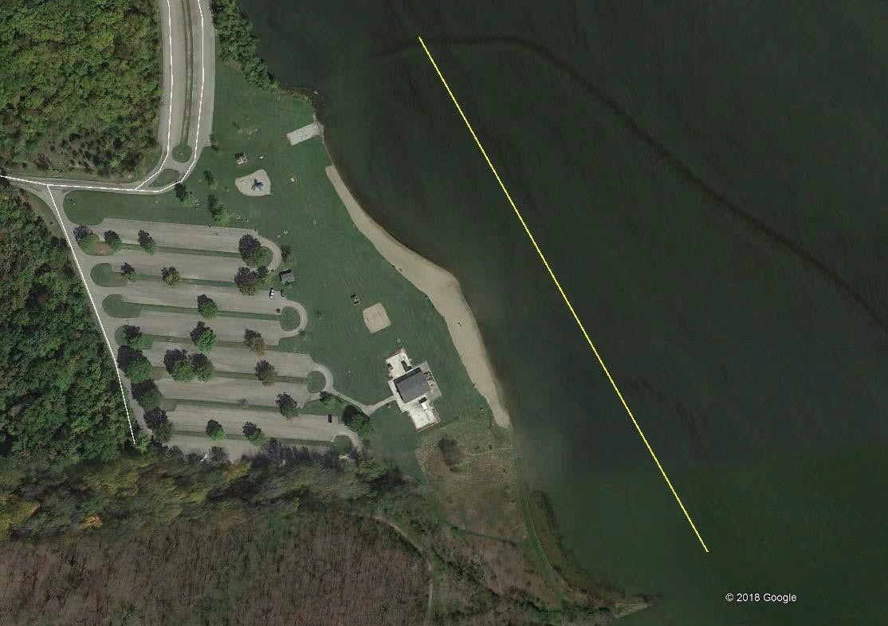
Course Evacuation Plan

Slide 13
5. Medical Services
2025 Plan:
Two EMTs will be on-site from the Prince William County Fire and Rescue Department.
4-6 more EMTs will be on the Fire & Rescue boat.
One additional EMT and Physician’s Assistant will be located at the Finish, observing and evaluating all finishing athletes.
We anticipate 200 athletes on the course at the peak of competition. This provides an MED ratio of one MED per 22.2 athletes on the course during peak competition.
1-2 ambulances from the Montclair Fire/EMT Departments will be on- site.

Slide 14
2025 Plan: Nearby Facilities
5. Medical Services (Continued)
Sentara Northern Virginia Medical Center, Hospital/ER 3.9 mi 2300 Opitz Blvd, Woodbridge, VA 22191 Open 24 hours (703) 523-1000.
The Safety Coordinator and Prince William Fire Department /EMTs and on-site ambulance has direct communications with the emergency room at Sentara Northern Virginia Hospital, and other EMT/Rescue county personnel.
All recommended medical equipment will be available in the on-site ambulance with the Montclair Fire Department EMTs.

Slide 15
6. Accounting For Swimmers
2025 Plan: The following “accounting for swimmer” system will be used.
Advance registration is required entry into The Open Water Championship. No deck entries or day-of-meet entries are allowed.
All competitors are pre-assigned competitor numbers on arms, and cap, possibly a 3rd set on back or hands.
All swimmers must check-in at Clerk Of Course, receive their tattoos, Race Ticket, and be marked with their competitor numbers. Any swimmer not checking in, is scratched.
All scratches are sent to Admin 30 minutes before each race.
After mandatory pre-race Instructional Briefing (Technical Meeting), all athletes enter the Pre-Race Assembly Area. Referee collects each Race Ticket re-confirming the Athlete Name & Competitor Number markings.
Any swimmer that decides not to compete, after checking in, the Race Ticket is collected by a Referee, sent to Admin, as a post check-in scratch.

Slide 16
6. Accounting For Swimmers (Continued)
2025 Plan:
7.
The Race Tickets for each event are sent to the Chief Finish Judge.
During each race, all swimmers who abandon prior to the finish are DQ’d, the DQ is sent to the Chief Finish Judge, and the Race Ticket is pulled and handed to the swimmer.
As each swimmer completes the race, their competitor number is recorded on the Order of Finish Sheet, by the Finish Judges.
As each swimmer completes the race, their Race Ticket is handed to the swimmer.
The Order of Finish Sheet is sent to Admin by the Chief Finish Judge immediately following the conclusion of each event, accounting for all competitors that started, and actually finished.
Any remaining Race Tickets (unaccounted for swimmers) are immediately investigated by the Chief Finish Judge and/or Administrative Referee back to the Coaches and/or Parents.
8.
9.
10.
11.
12.

Slide 17
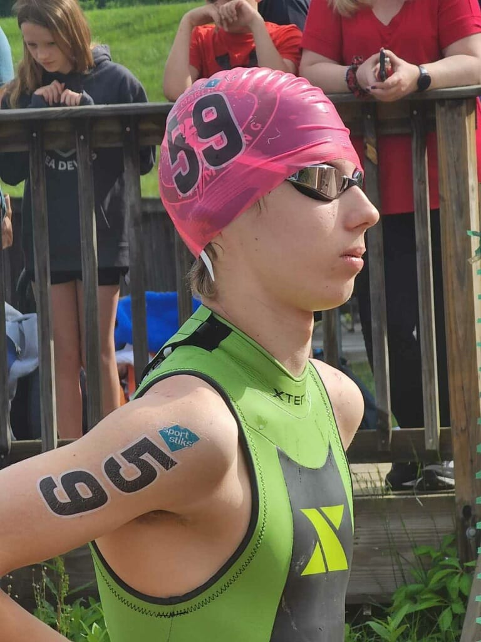

6. Accounting For Swimmers (Continued)
2025 Plan: Race Ticket Example

Slide 18
7. Technical Meeting/Pre-Race Briefing
2025 Plan:
The pre-race instructional briefing (technical meeting) will contain the following:
Course Layout
Rules of the swim (Officiating – Yellow/Red Flag)
Water conditions
Marine Life
Weather Conditions
The Safety Plan
Emergency Conditions

Slide 19
7. Technical Meeting/Briefing (Continued)
2025 Plan:
The Safety Communication Plan
The Evacuation Plan for clearing the race course (abandonment)
Safety Craft & Safety Personnel (lifeguards, paddle-boarders, kayakers)
On-site EMTs & ambulance – Oxford Fire Department EMTs
Emergency Phone Numbers (park rangers, police, emergency room, etc.)
Local Hospital – McCullough-Hyde Memorial Hospital

Slide 20
8. Safety during pre-race warm-up and post-race warm-down
2025 Plan:
A designated warm-up is available (8-8:45 a.m)on the portion of the race course closest to the finish area prior to the start of the 5K. The technical briefing (8:45-8:55 a.m.). Certified lifeguards on shore and kayakers will be on-duty during all warm-up and is closed to all boating traffic during these times. Cool down will not be available.

Slide 21
9. Water and Air Temperature
2025 Plan:
Three Thermometers (with both marking in Celsius and Fahrenheit) will be used before & during competition.
Two Water Temperature Thermometers, located on the Turn Judge Boats, will be used to monitor Water Temperature.
One Air Temperature Thermometer, located in the Administration Tent,
will be used to monitor Air Temperature.
Temperatures will be recorded by Safety Officer (or designee):
30 Minutes before competition (8:30 a.m.)
Hourly throughout the competition (beginning at 9:00 a.m.)
Posted on Whiteboard at Competition for all Athletes, Coaches, and
Parents.

Slide 22
9. Water and Air Temperature (Continued)
2025 Plan:
Follow Requirements:
If the water temperature is below 16° C (60.8° F), no race can be held.
For races of 5K and above, if the water is above 29.5° C (85° F), no race can be held.
If the air temperature and water temperature added together
are less than a total of 30° Celsius (118° F), no race can be held.
If the air temperature and water temperature added together (in Celsius) are greater than 63° Celsius (177.4° F), no race can be held.

Slide 23
9. Water and Air Temperature (Continued)
2024 Actual Measurement:
Water Temperature
The water was measured at 68.5° F at 8:30
AM on 5/19/2024.
Air Temperature
The Air Temperature was measured between 60.5° F and 80° F.
Combined Water & Air Temperature ranged from
128.5° F to 150.3° F

Slide 24



9. 2024 Actual Air & Water Temperature
2024 Montclair Open Water Swim Festival May 19, 2024 Lows Avg & Highs
5/19/24 | Temp F |  | Water Temp F | Wind | Weather
Low | 60.5 |  | 69.4 (6:52 a.m.) | 0.00mph | Clear
Avg | 72.3 |  | 71.9 | 7 mph | Clear
High | 80.8 |  | 74.8 (5:48 pm) | 14.1 mph | Clear
data source: Ambient Weather

Slide 25
10. Water Quality
2025 Plan
The venue, Dolphin Beach (Lake Montclair) is a water reservoir in Prince William County, VA. Water quality monitoring is performed by the Montclair Property Association.
The Water Quality Report is published and reported to the community
each week.
The Water Quality Report will be monitored & published for the week prior to May 19, 2025, the day of the meet, and the week after the event by our independent safety monitor, as well as, the MPOA.
If the Water Quality exceeds Virginia standards, “in freshwater, E. coli bacteria shall not exceed of a statistical threshold value (STV) of 410 counts/100 mL, both in an assessment period of up to 90 days,” then the event will be canceled.
25

Slide 26
10. Water Quality – Actual – Week of actual & week after meet
Locations: Dolphin, West & Beaver Beaches
Dates: Time: Results:
06/6/23
3:05 pm
Beaver: 38MPN/100mL
West: 55 MPN/100,:
Dolphin: 82 MPN/100mL
Legend: Virginia Department of Health Water Quality recommendations for public
beaches of less than 410 per 100ml of water.
26

Slide 27
